Slide 1
Rheology: The science that study the flow
and deformation of materials.
Flow is generally associated with liquid behavior. Flow
can be regarded as a deformation rate
Deformation is generally associated with solid/semisolid
materials

Slide 2
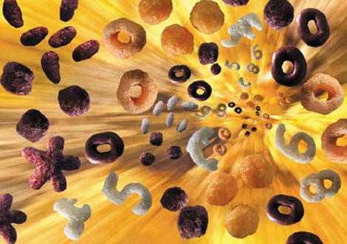
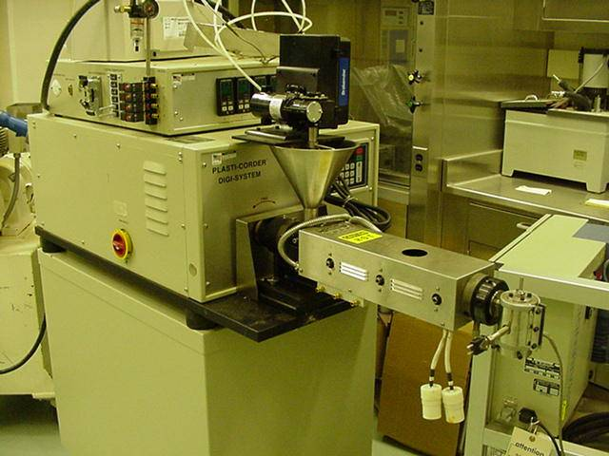
Example – Rheology in a extrusion process
Extruded (expanded products)
Single Screw Extruder

Slide 3
Product Expansion and Quality
Bubble
Steam
Air
Moisture
Heat
Die
Puff
Collapse
Set
Harden
Temperature
P, T
Pressure
Boiling Pt.
Newtonian
Viscoelastic material
0
0
TIME
Notes:
draw graph on equation sheet

Slide 4
RHEOLOGICAL PHENOMENA
Low Molecular Weight Solutions (monomer)
Liquid Behavior
High Molecular Weight
Solutions
Viscoelastic Liquids
Very High Molecular
Weight Solutions
Viscoelastic Solids
Structure Dependent
Response, Structure
Recovery and Breaking
Macrostructural Materials
Colloidal Suspensions
Background for these lectures. Rheological Methods In Food Process Engineering. 2nd Edition. Chapter 1. J. Steffe. Check Blackboard Extra Information for Class (Steffe.pdf)

Slide 5
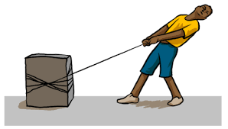


Concepts in Rheology
Stress and Strain
Since we are determining the rheological properties of the same material (which should be independent on the size of the sample) we need to normalize forces and deformations

Slide 6
Strain and Stress Concepts - Stress Distribution
Force
Deformation
Stress
It is important to know
the stress and strain distribution
in the whole area of the material
Strain
Vmax
Velocity Profile
Shear Stress Distribution
Notes:
force associated with stress, deformation associated with strain

Slide 7
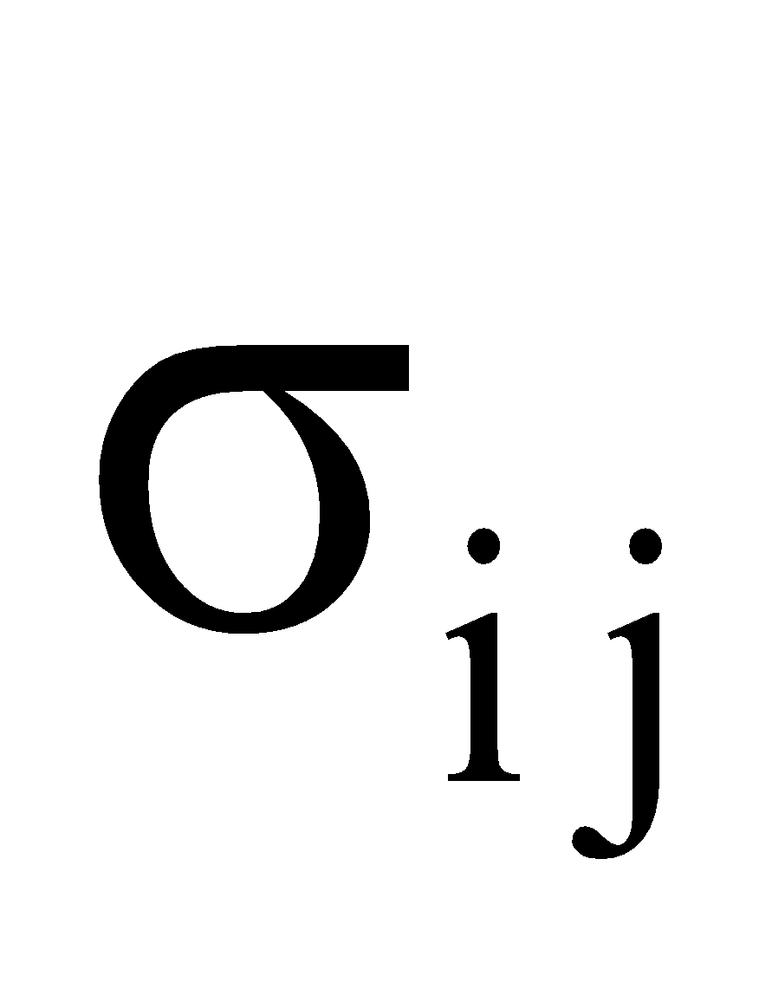
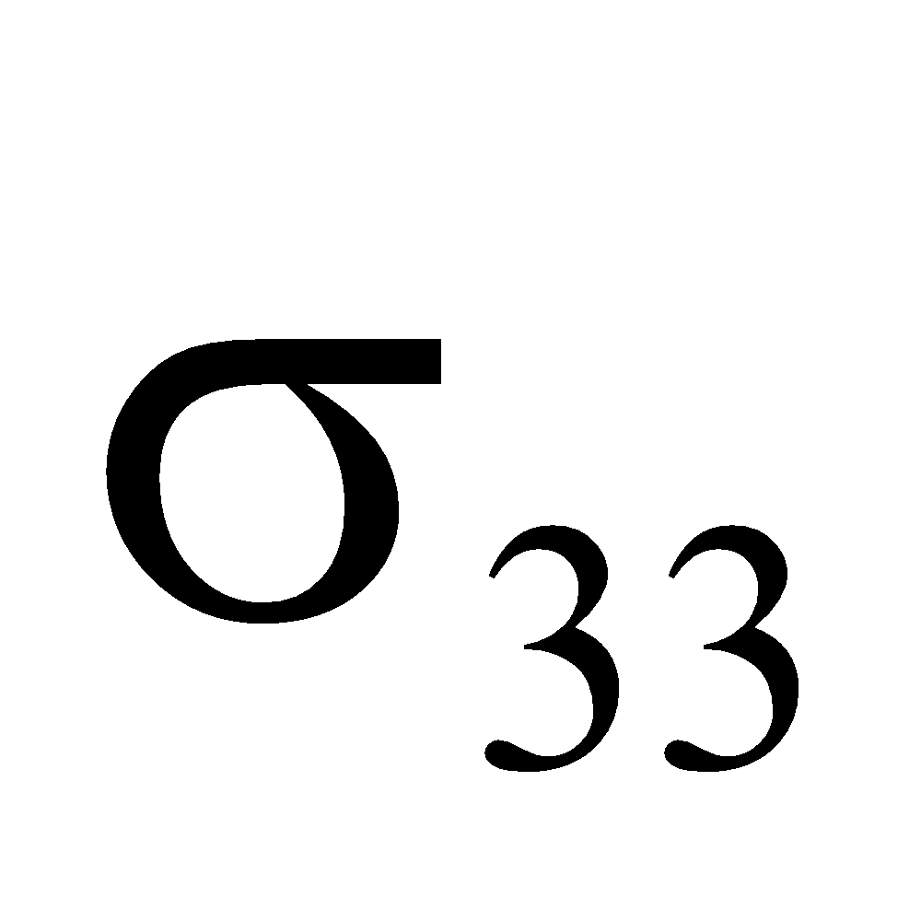
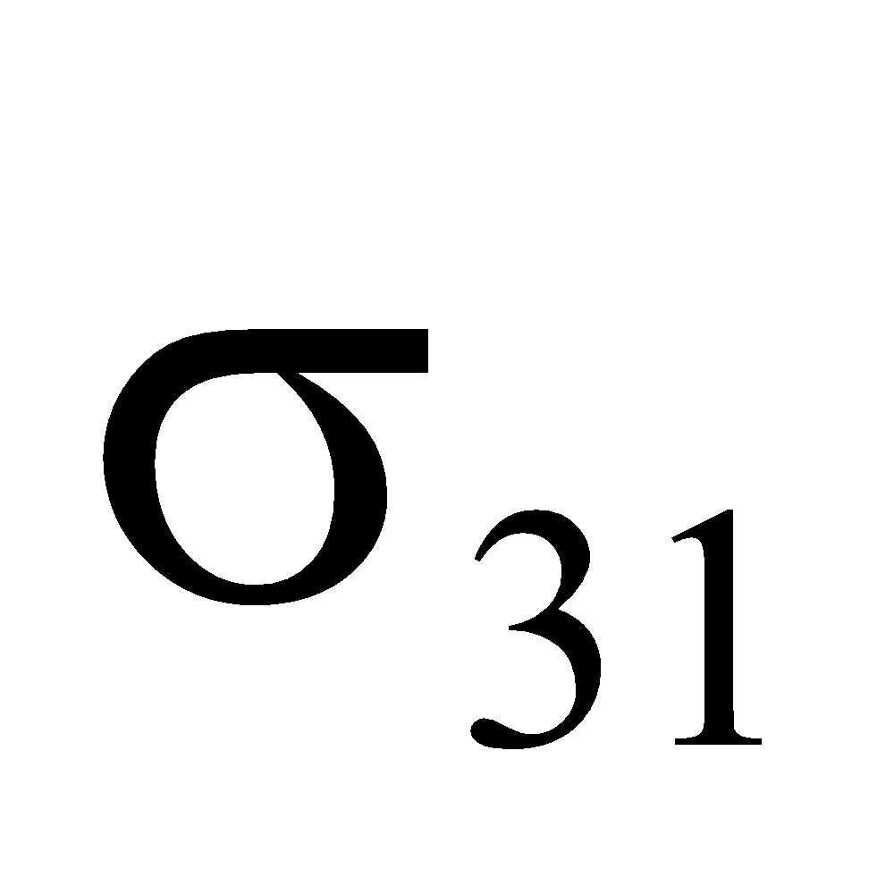
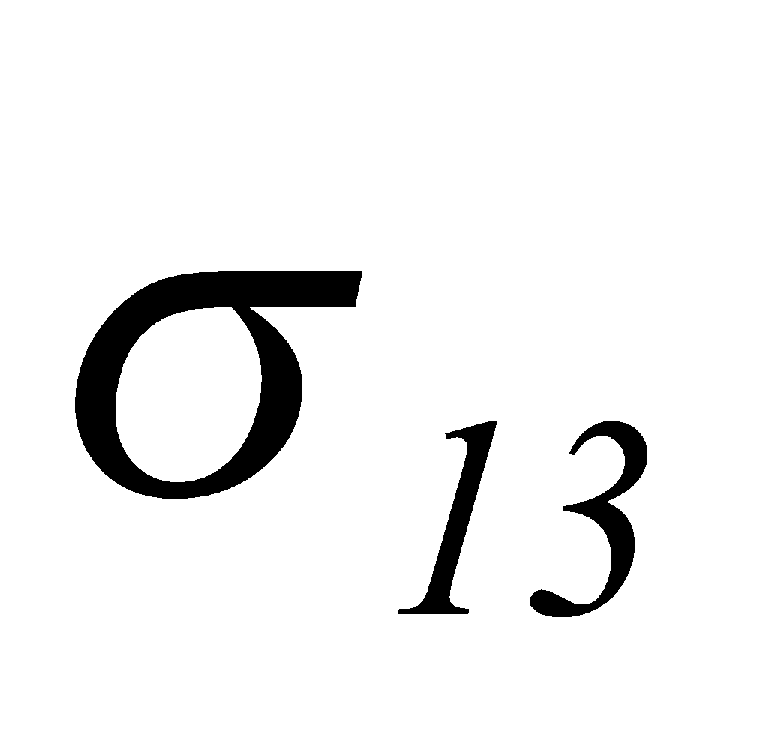
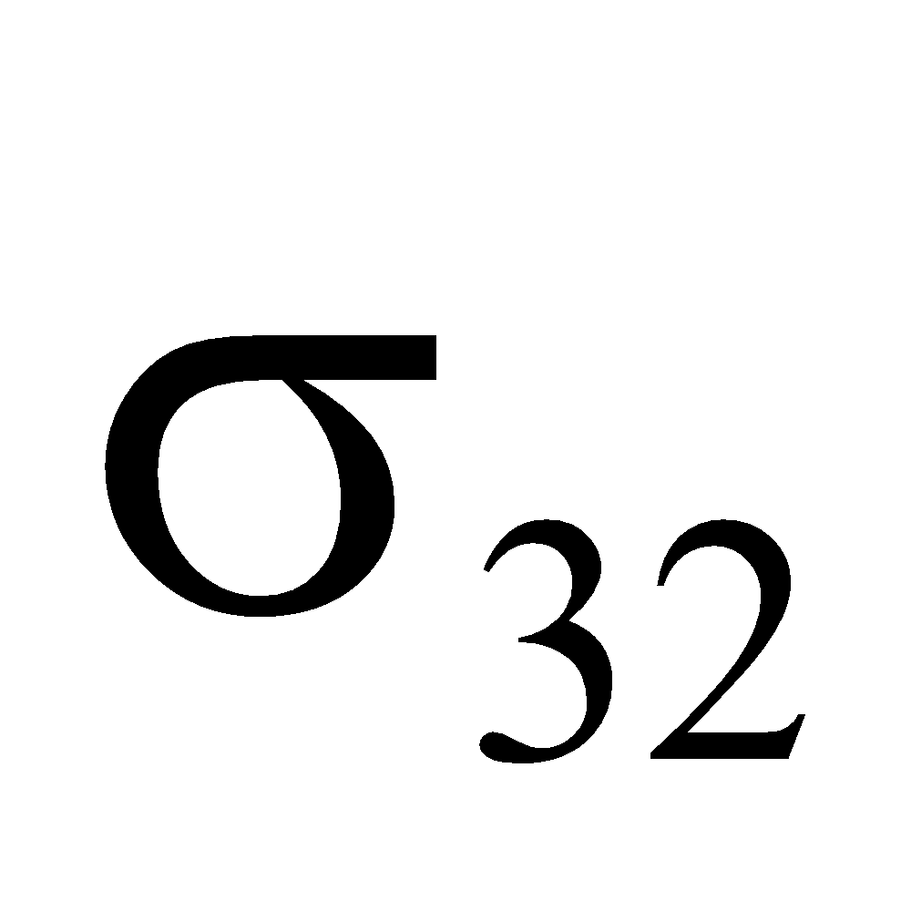
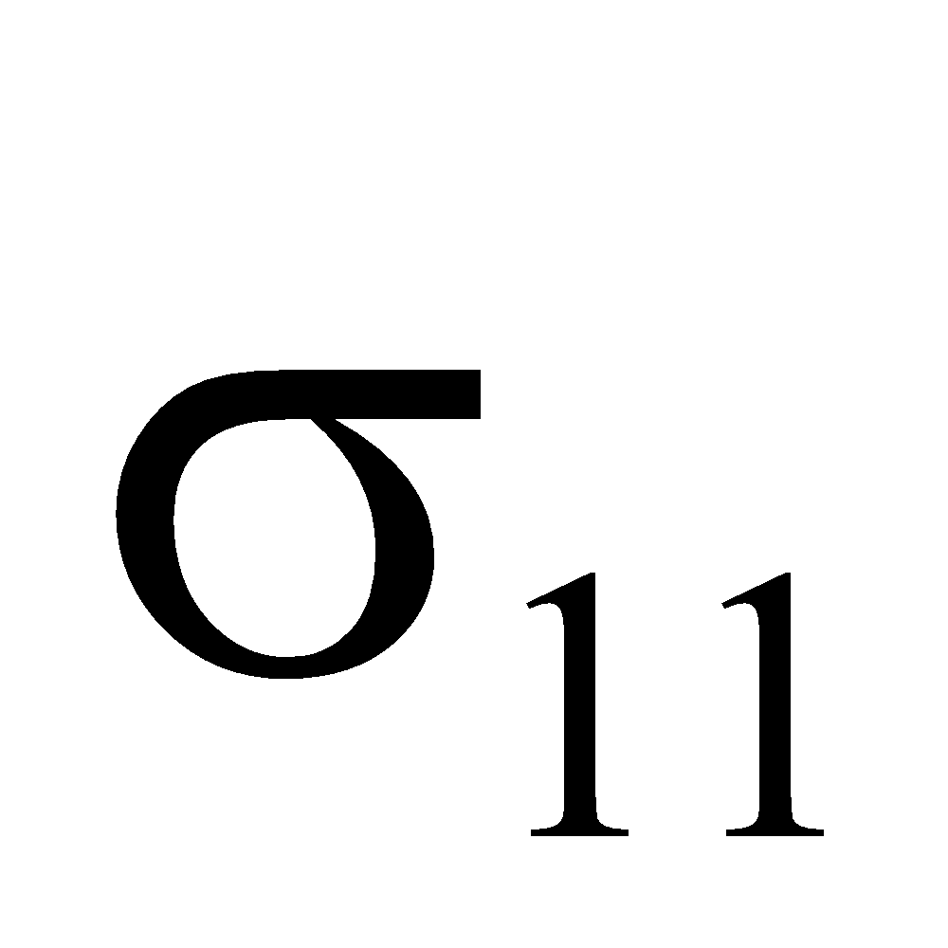
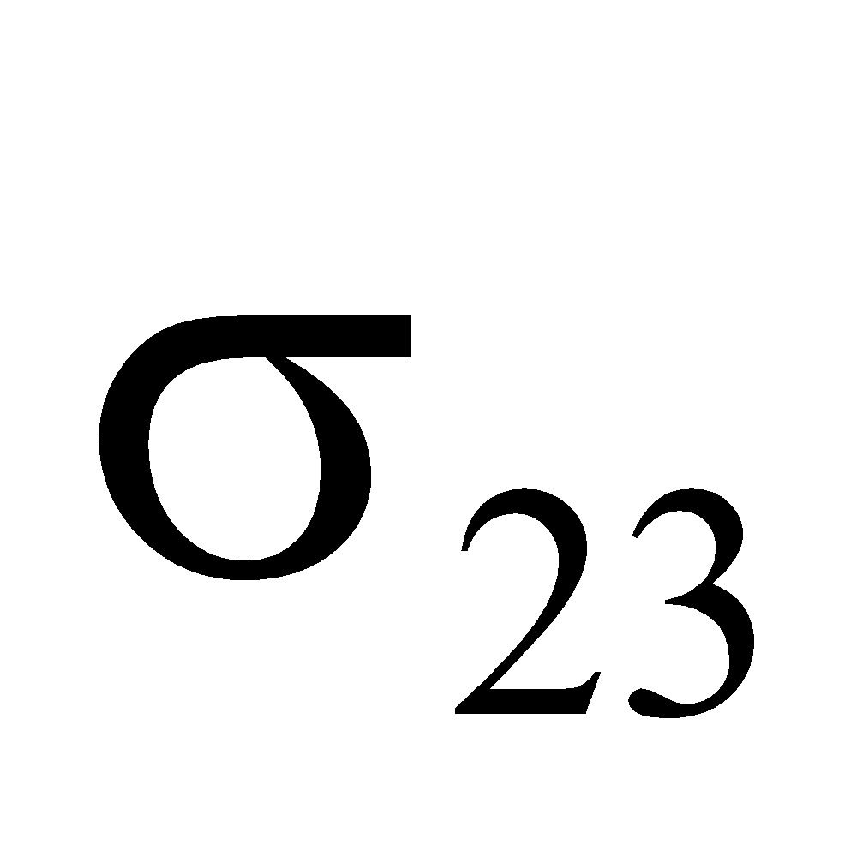
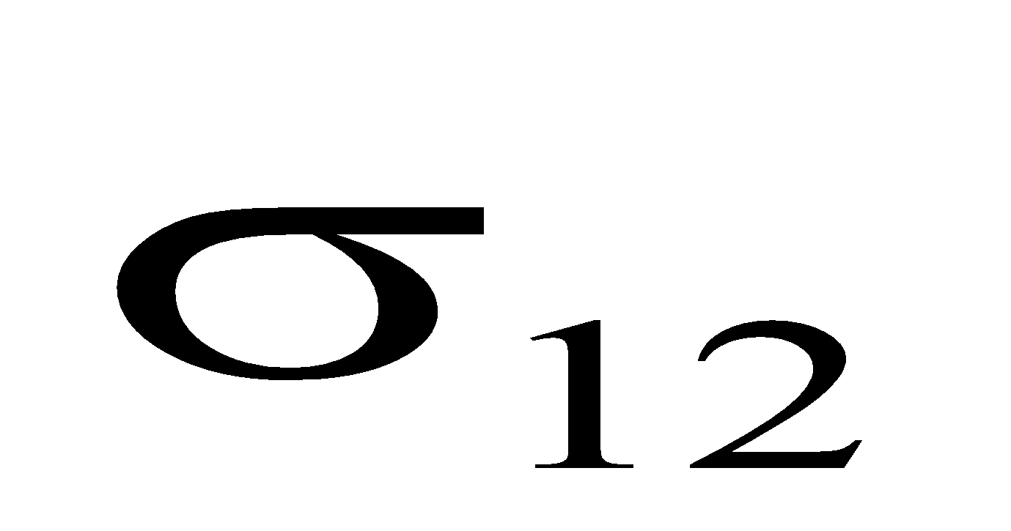
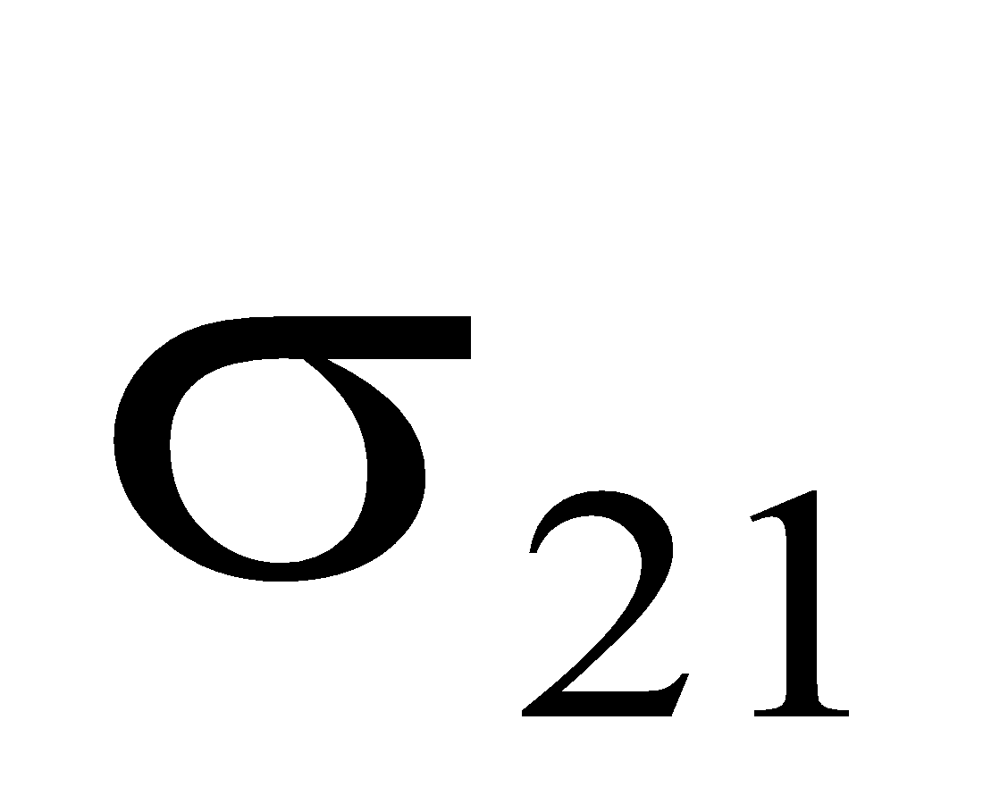
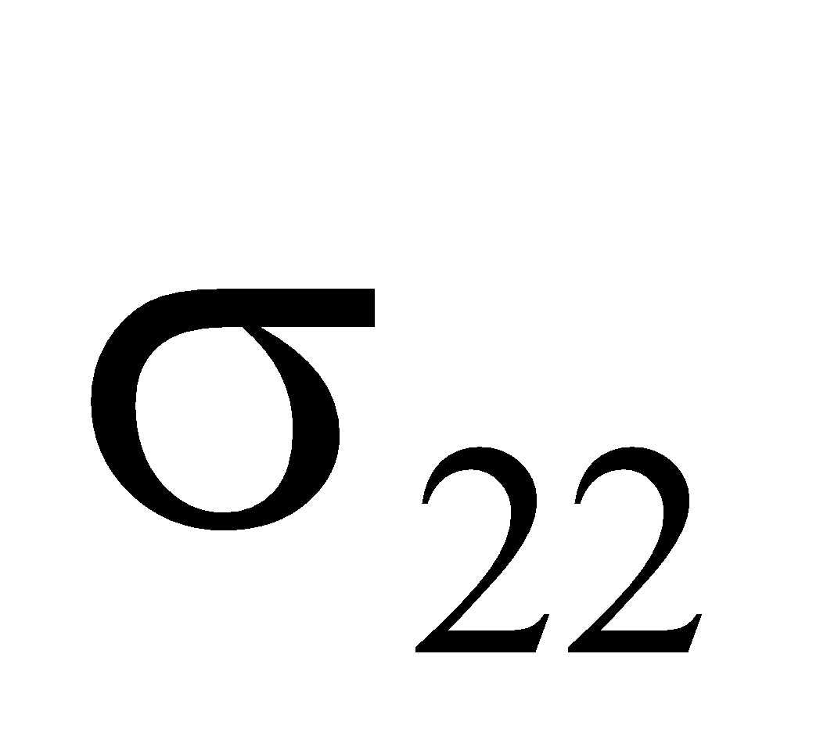
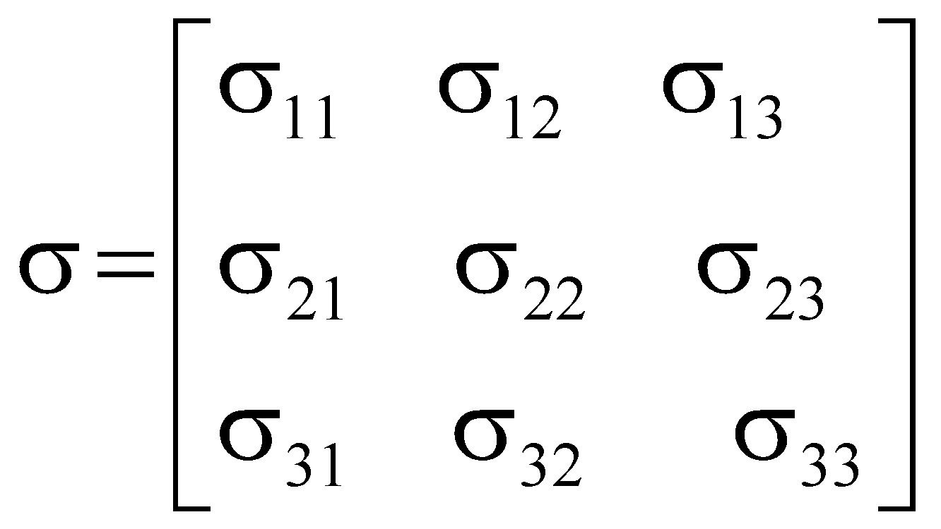
Stress Tensor and Strain Tensor Concepts
3
Force
Point in the body
1
2
3
This subscript indicates
the direction of the stress
This subscript indicates
the direction of the normal
to the area
1
2
Stress Tensor

Slide 8
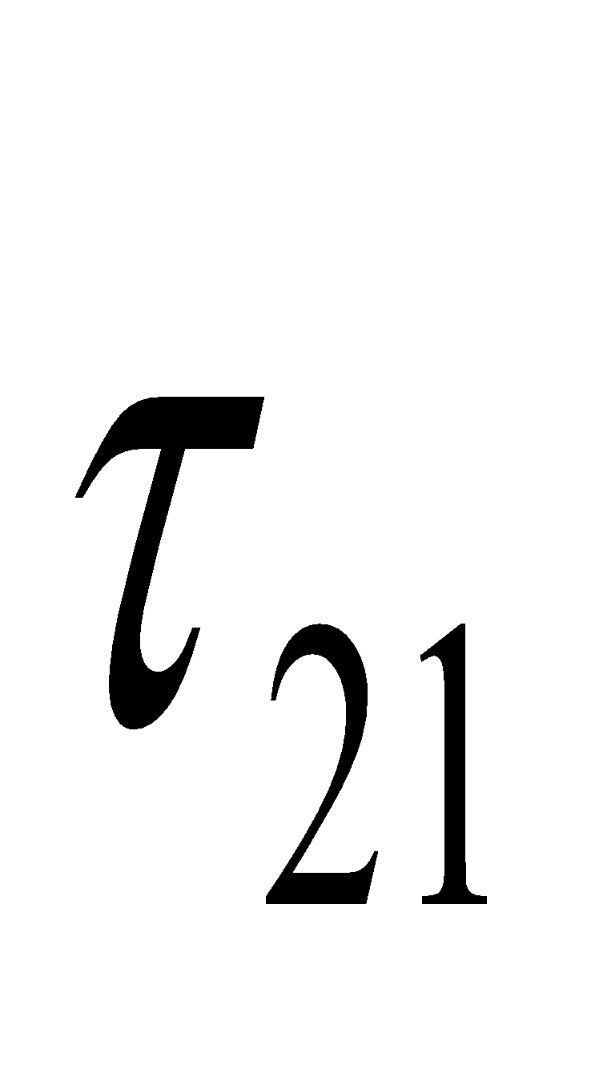
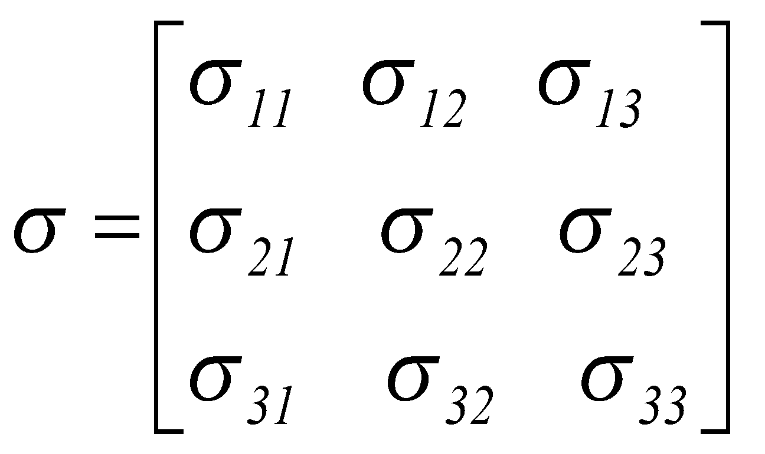
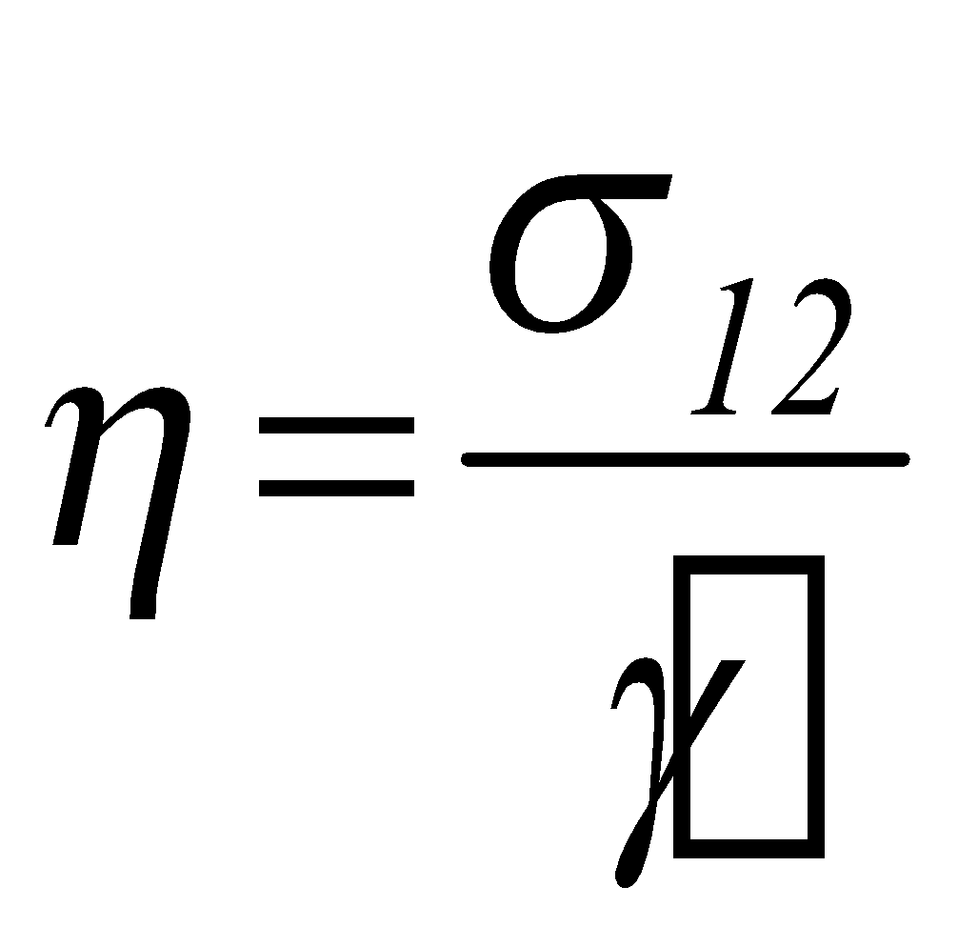
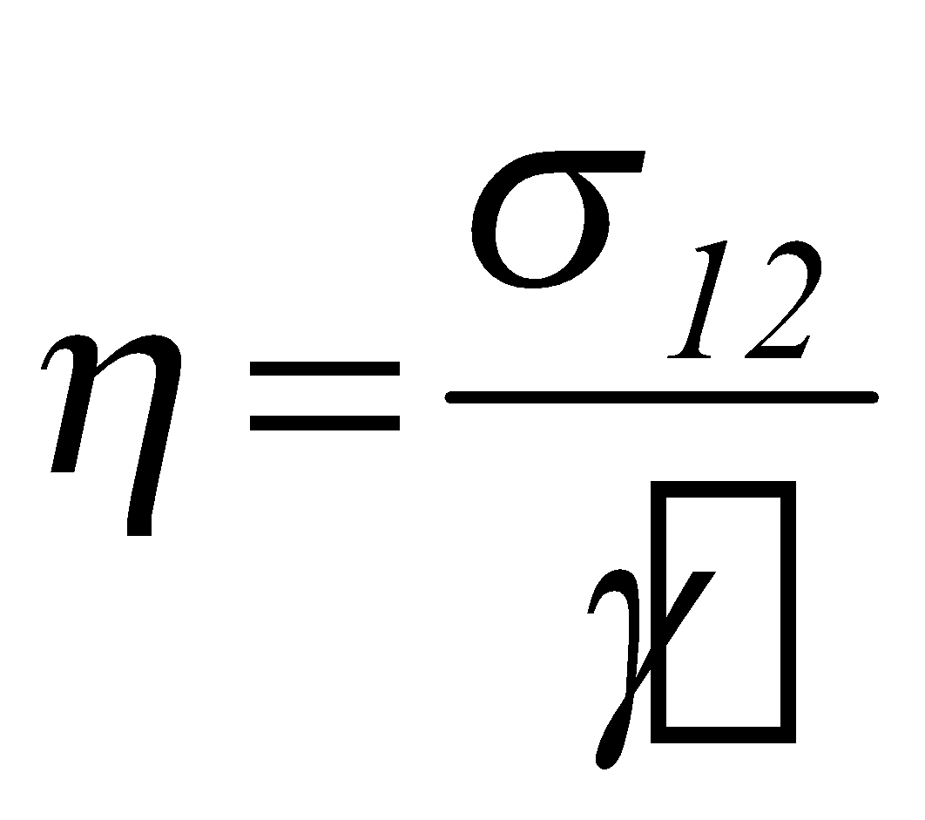
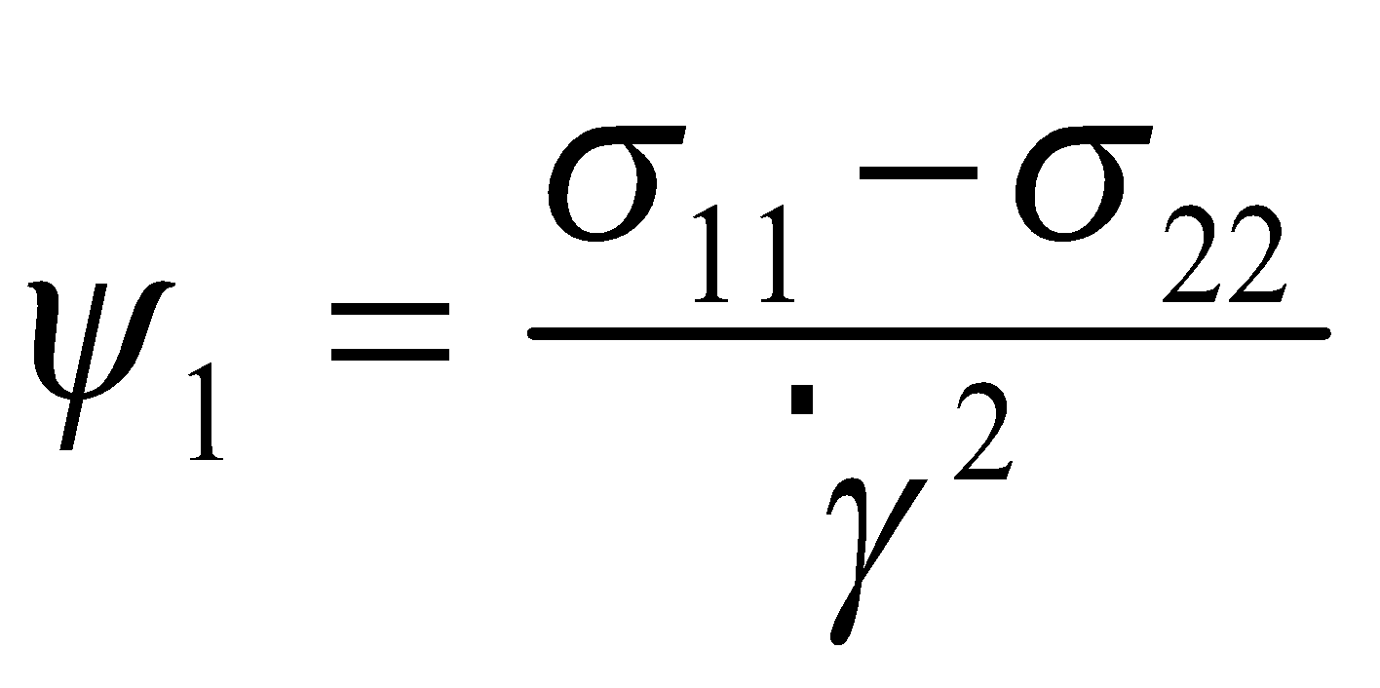
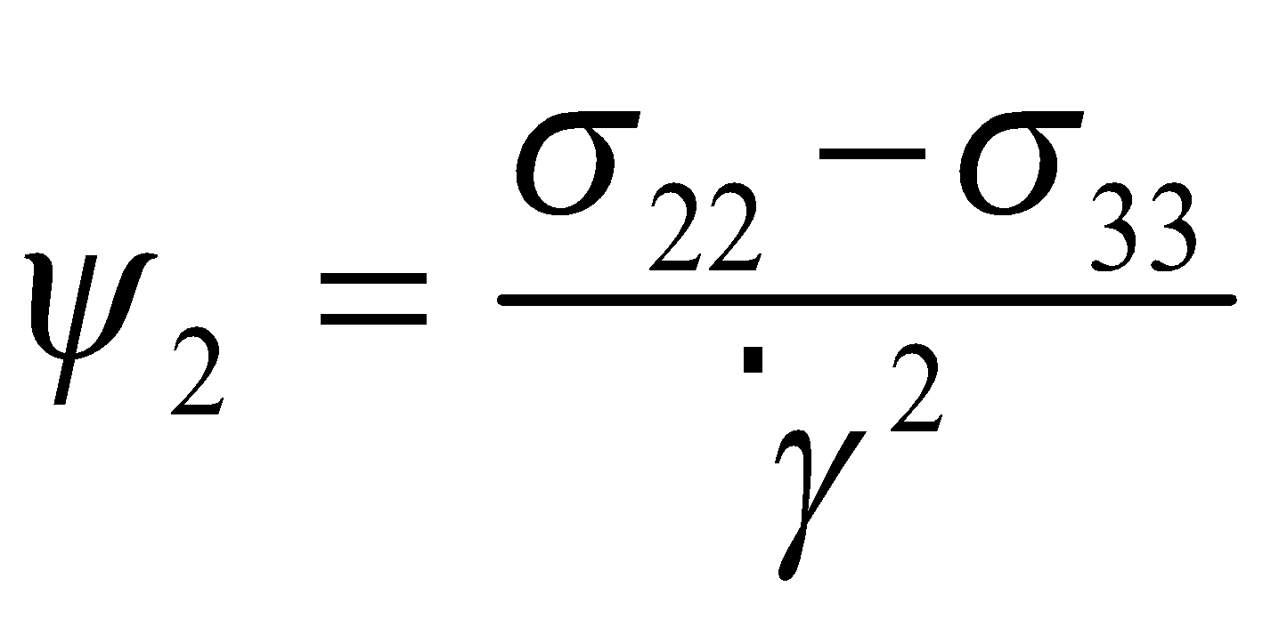
2
1
y (or 2)
V
F
h
Velocity Profile
u(y)
x (or 1)
Stress Tensor
Non-Viscoelastic Fluid
Viscoelastic Fluid
Shear Viscosity
First Normal Stress
Coefficient
Second Normal Stress
Coefficient
Notes:
the psi equations are not on the equation sheet

Slide 9
Rheology Video

Slide 10
Elastic Effects In Extrusion of Materials
DIE SHAPE
EXTRUDATE SHAPE

Slide 11
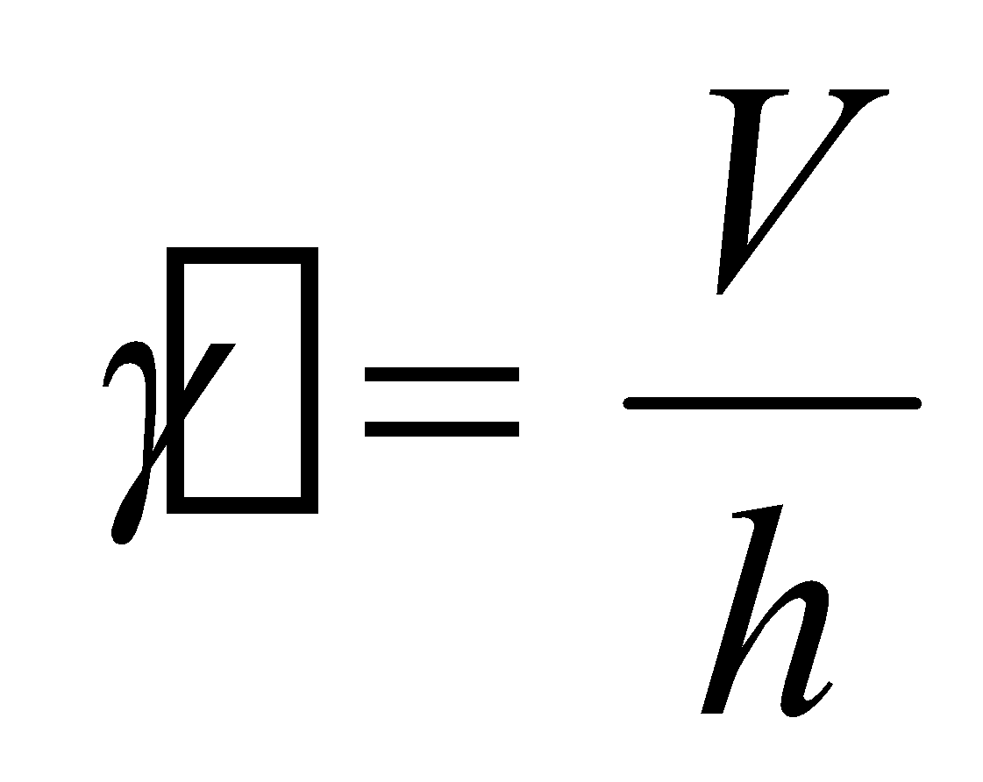
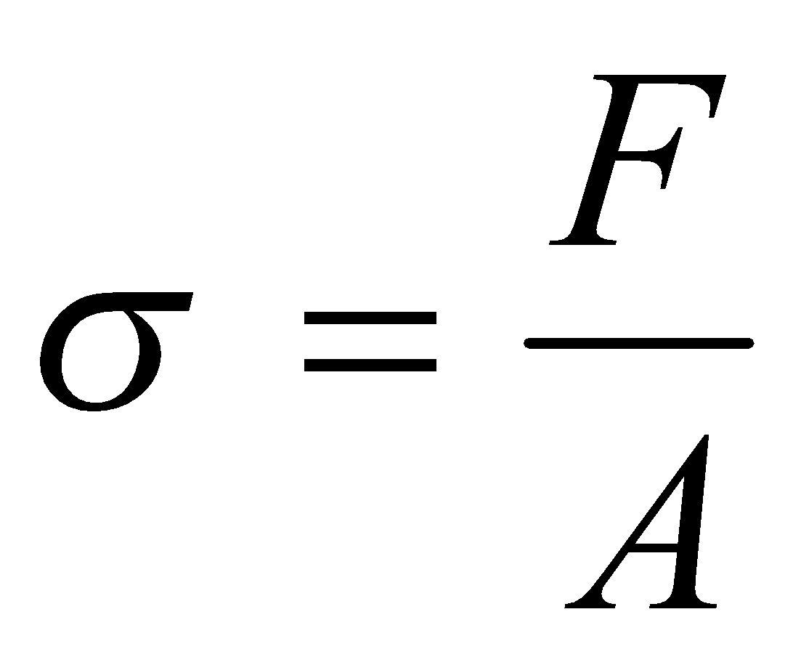
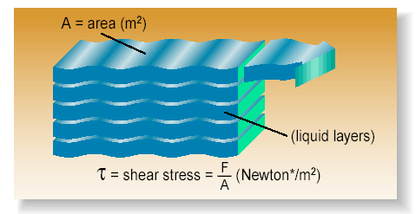

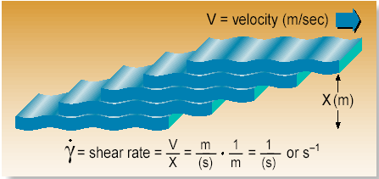
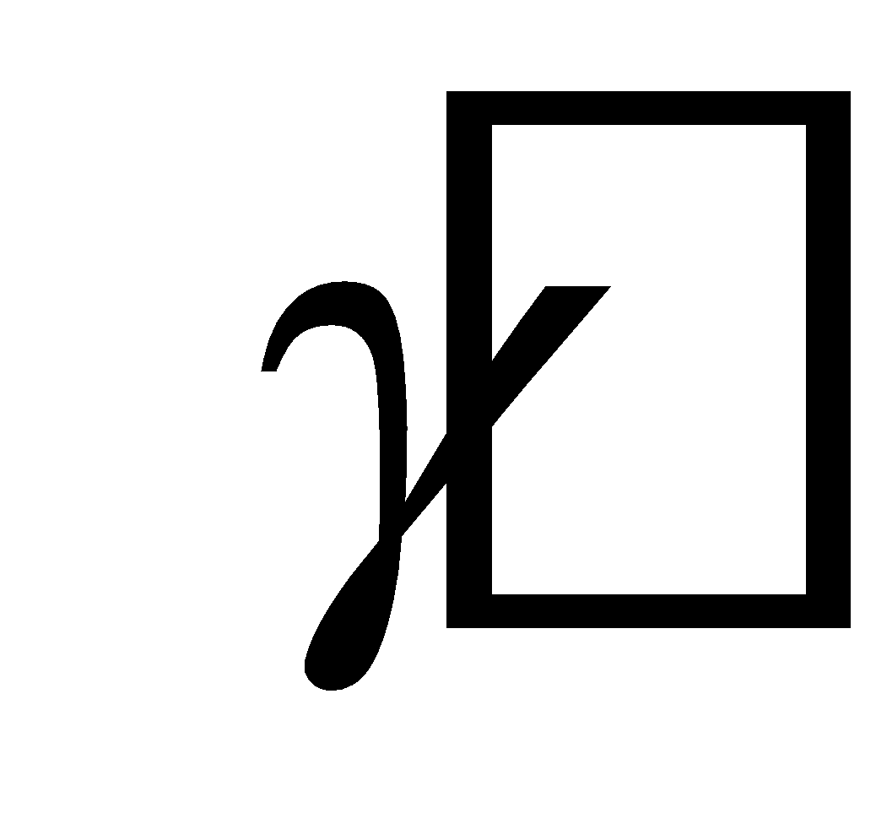
LIQUIDS
Ideal Shear Test
V
F
Velocity Profile
u(y)
h
Shear Rate
Shear Stress
Flow Curve

Slide 12
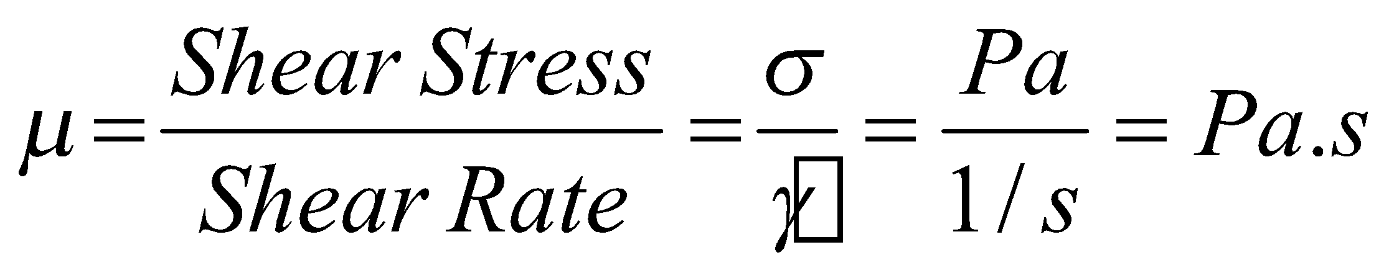
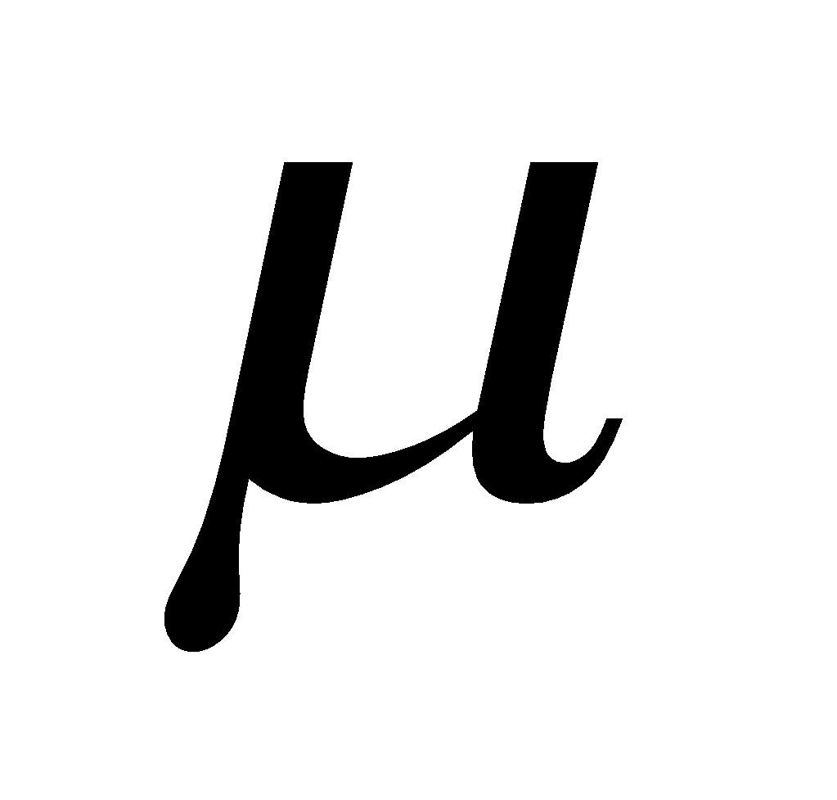
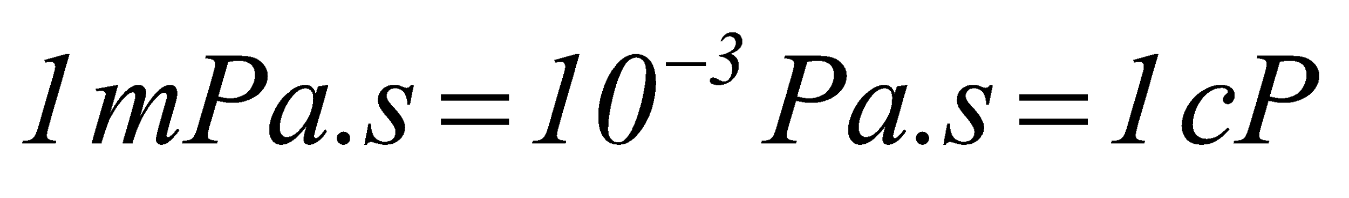
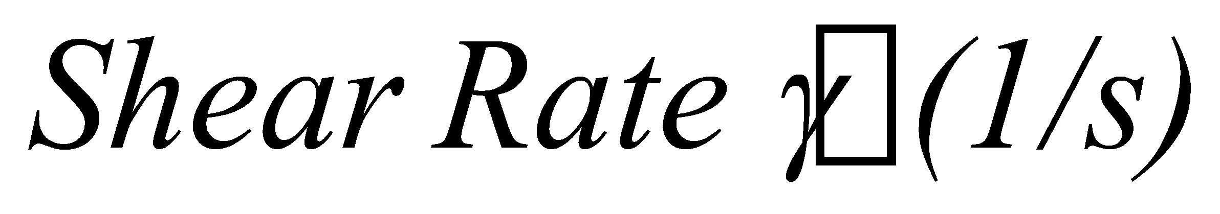
Newtonian Liquids
Shear Stress (Pa)
Water
Sucrose Solutions (up to concentrations of 60%)
Skim milk
Oil
Glucose Solutions (not very concentrated)
Diluted Juices

Slide 13
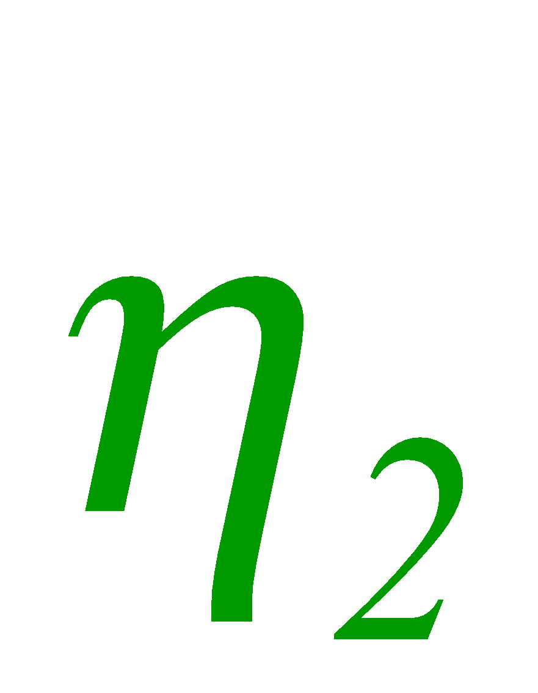
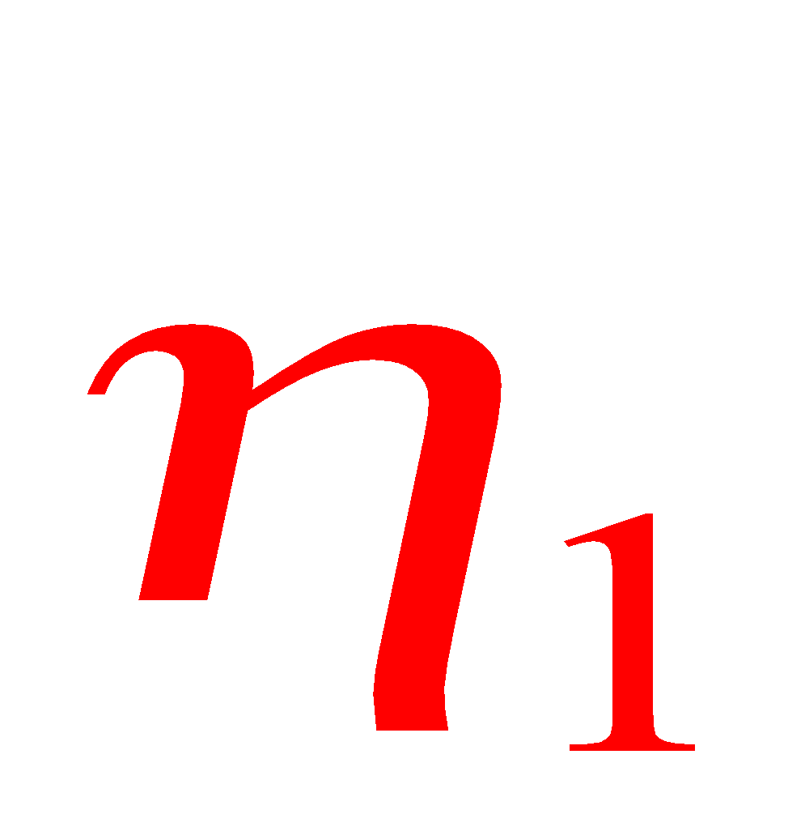
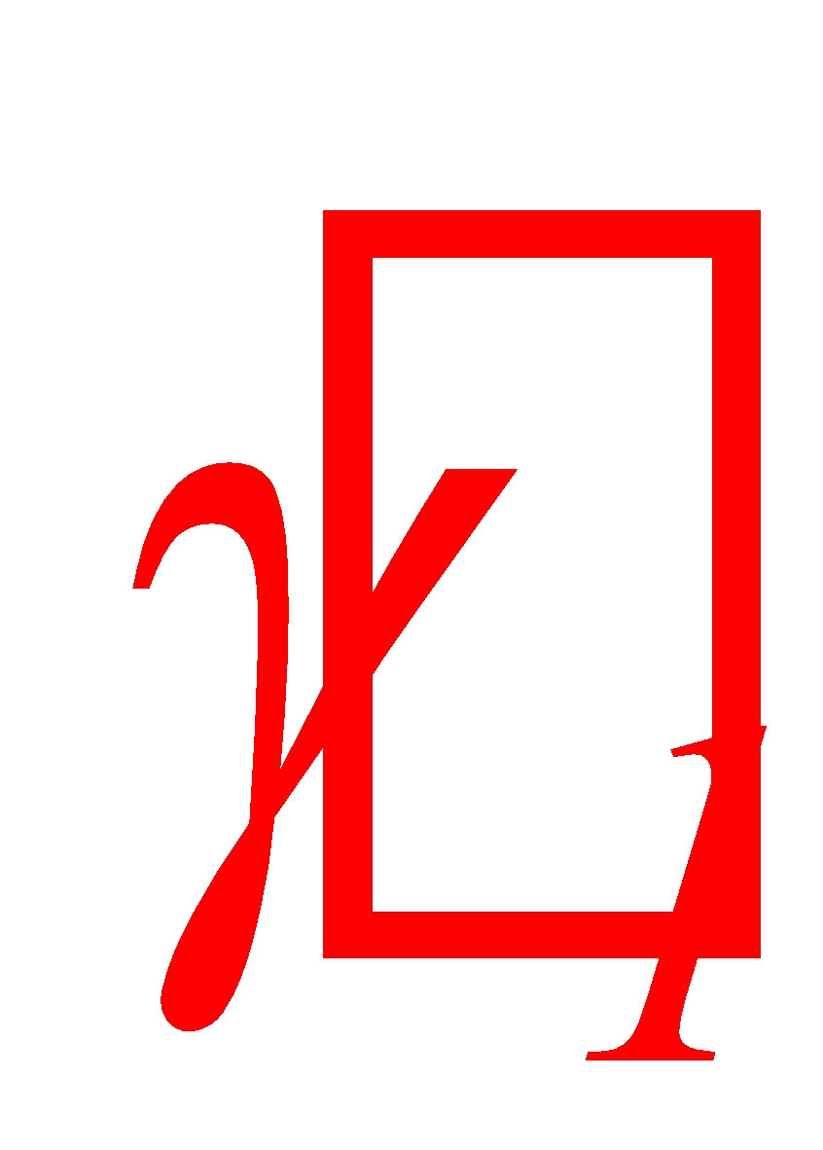

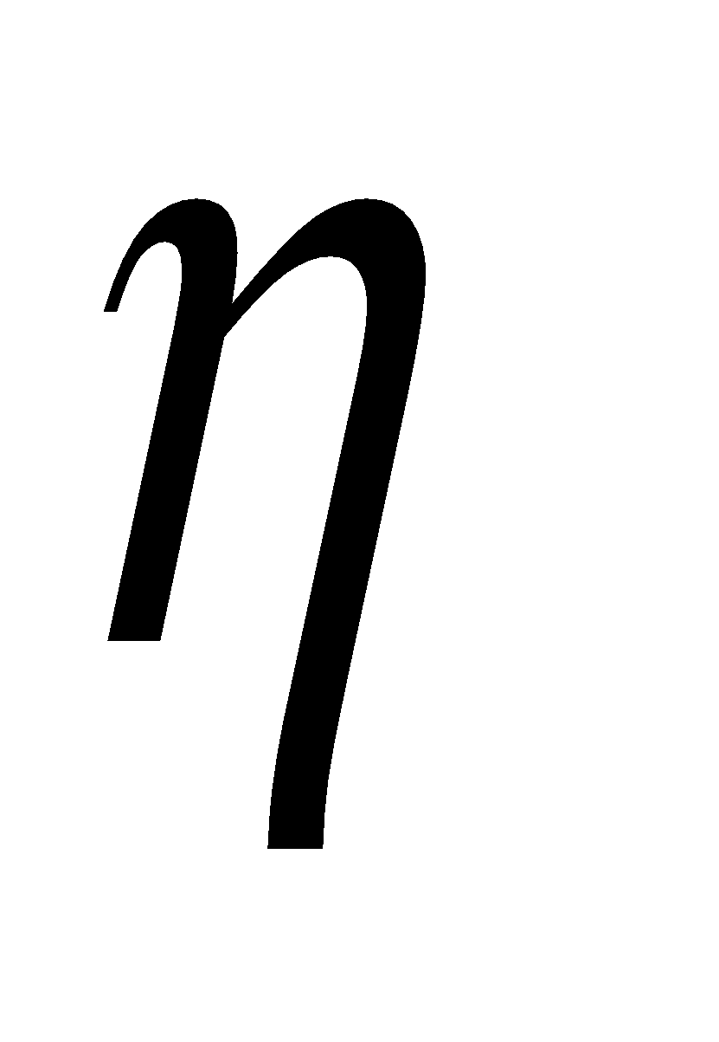
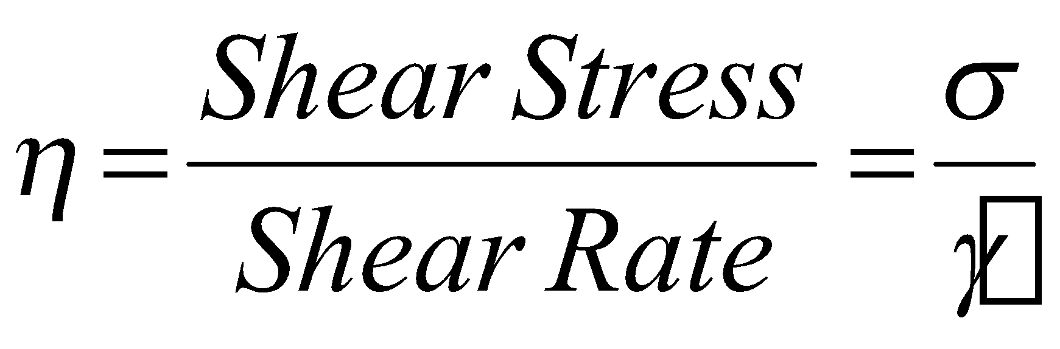
Non-Newtonian Liquids (Time independent)
Pseudoplastic liquids (shear thinning fluids)
Pseudoplastic liquids
Shear Stress
Shear Rate
Apparent Viscosity :
Notes:
power law

Slide 14
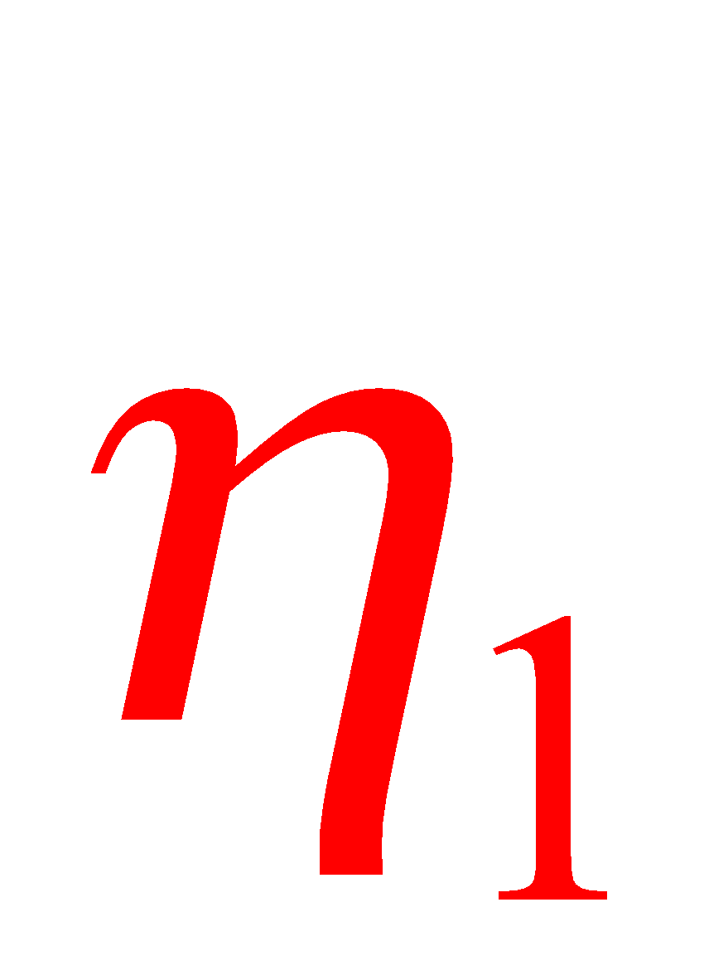
Non-Newtonian Liquids (Time independent)
Dilatant liquids (shear thickening fluids)
Dilatant liquids
Shear Stress
Shear Rate
Apparent Viscosity :

Slide 15
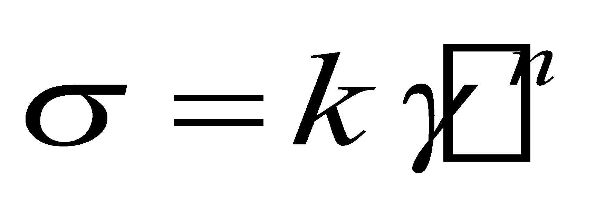
Rheological Models
Power-Law Model
k : Consistency Index (Pa.s^{n})
n : Flow Index (-)
If n < 1 liquid is shear thinning (or Pseudoplastic)
If n > 1 liquid is shear thickening (or Dilatant)
If n = 1 liquid is Newtonian

Slide 16
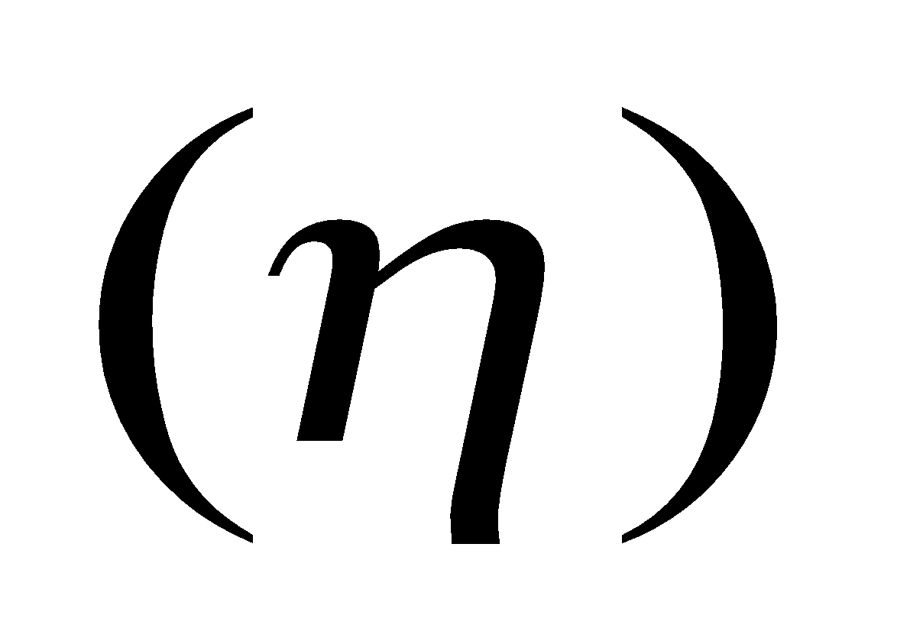
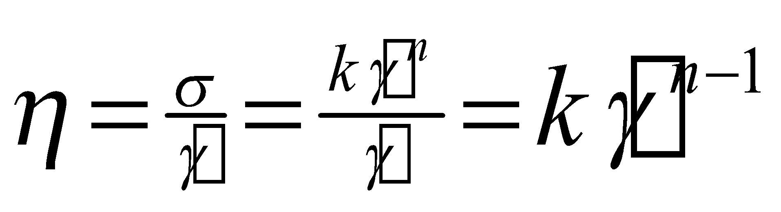
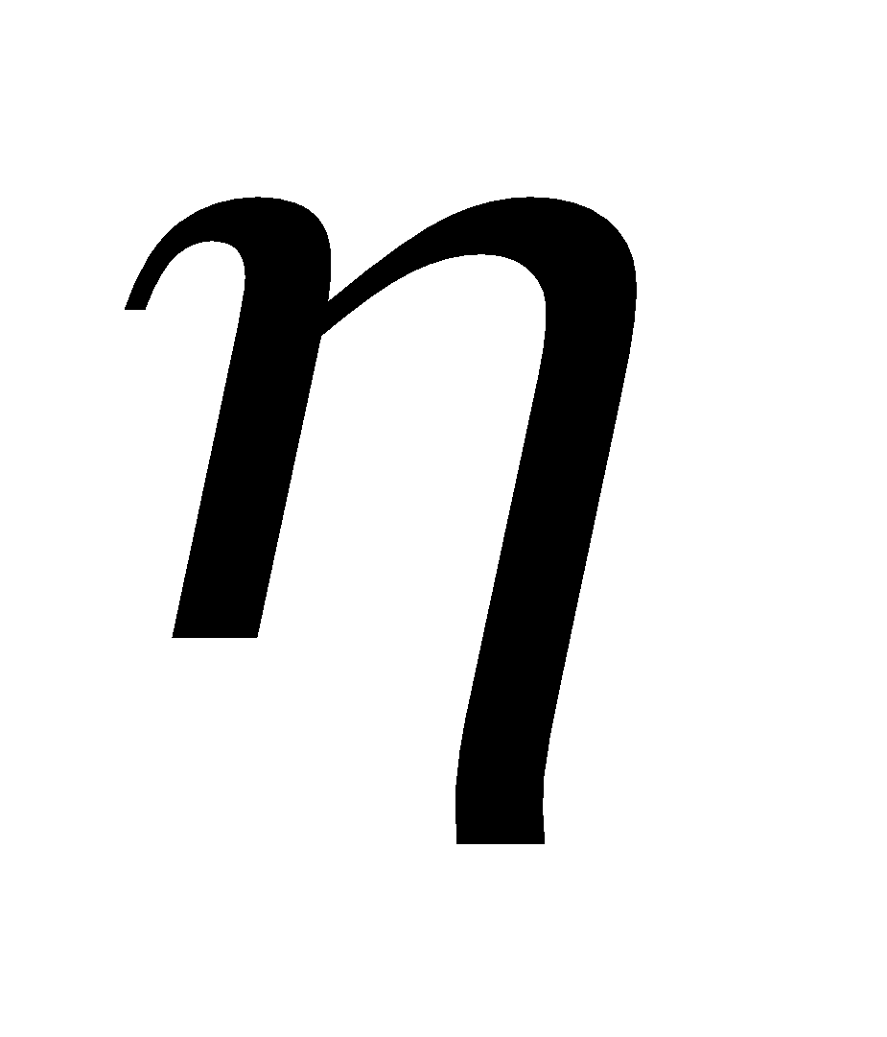
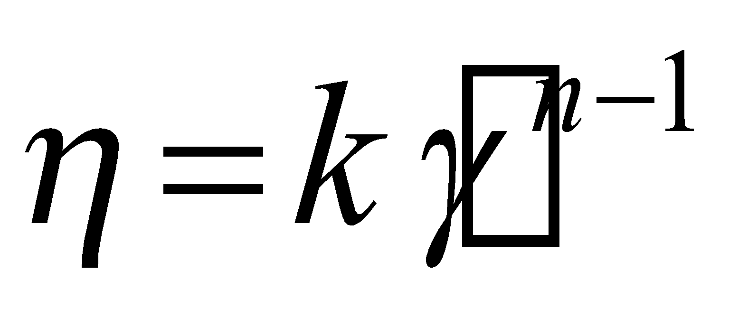
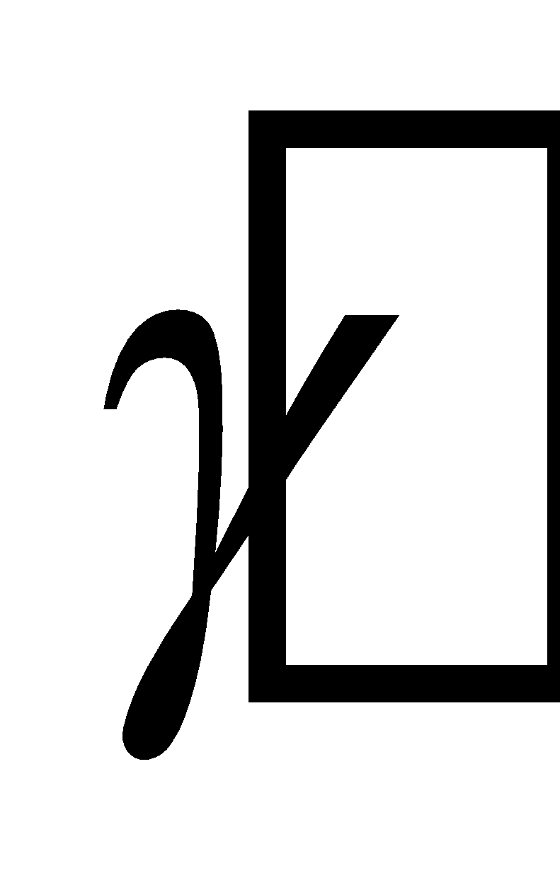
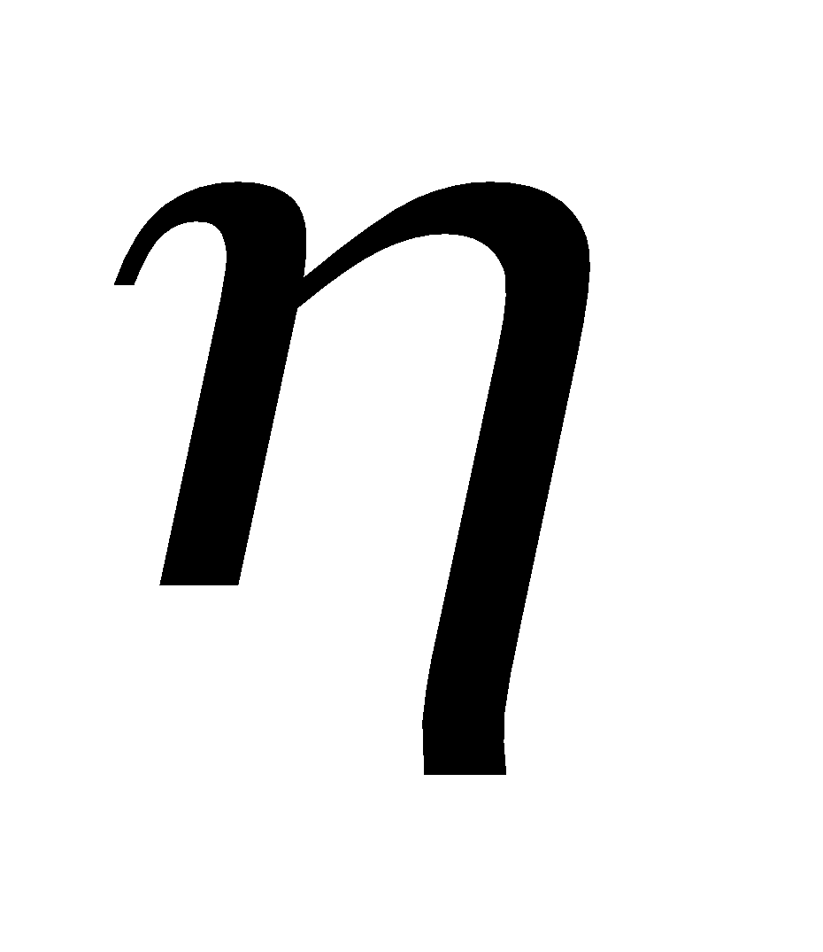
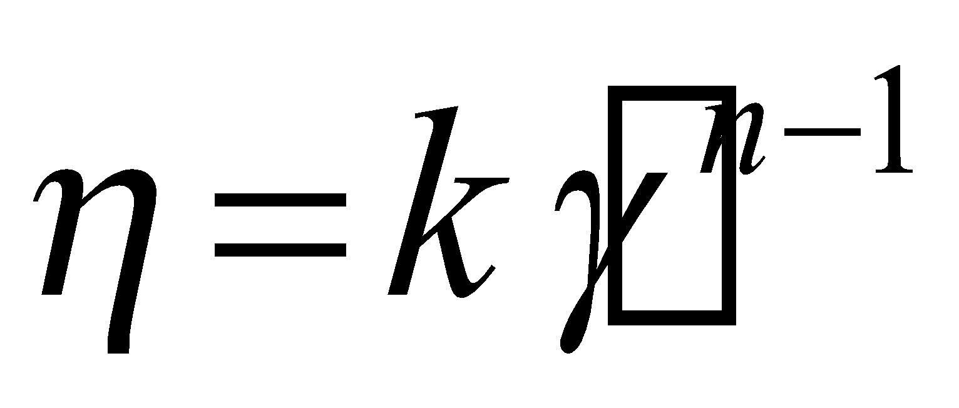
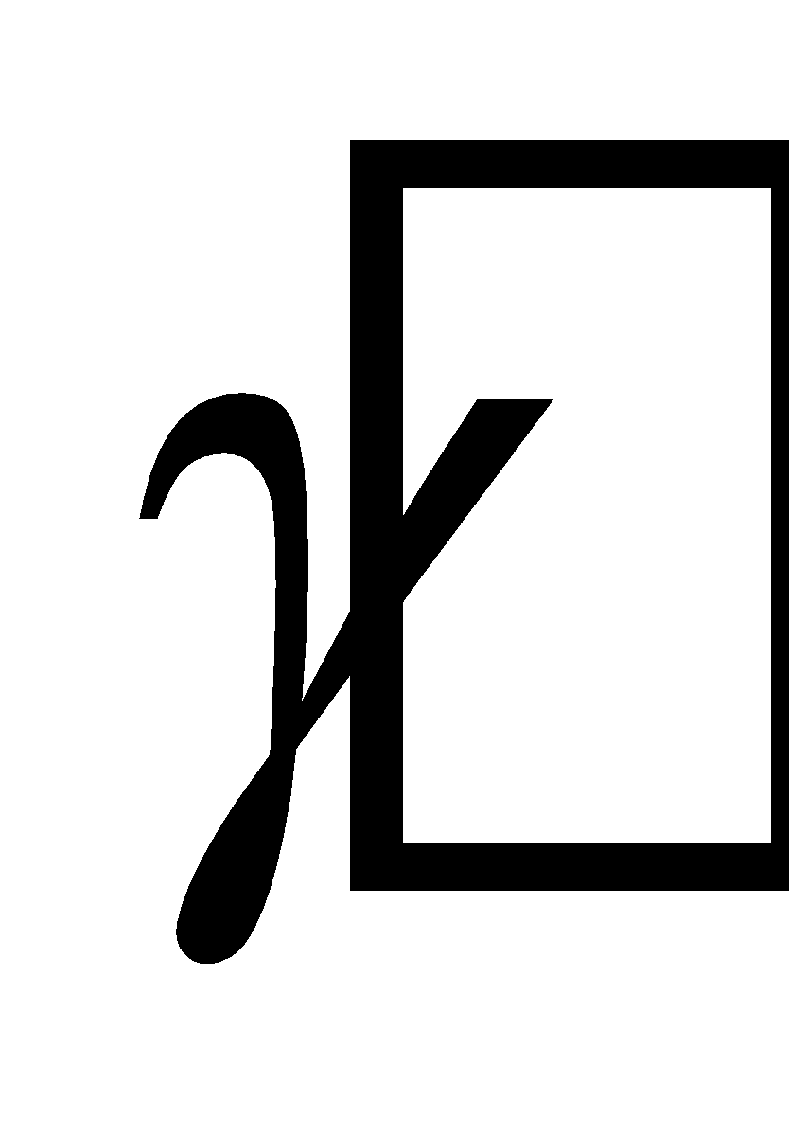
Concept of Apparent Viscosity
Shear Thinning (Pseudoplastic) Liquids n - 1 < 0 (n < 1)
Shear Thickening (Dilatant) Liquids n - 1 > 0 (n > 1)

Slide 17
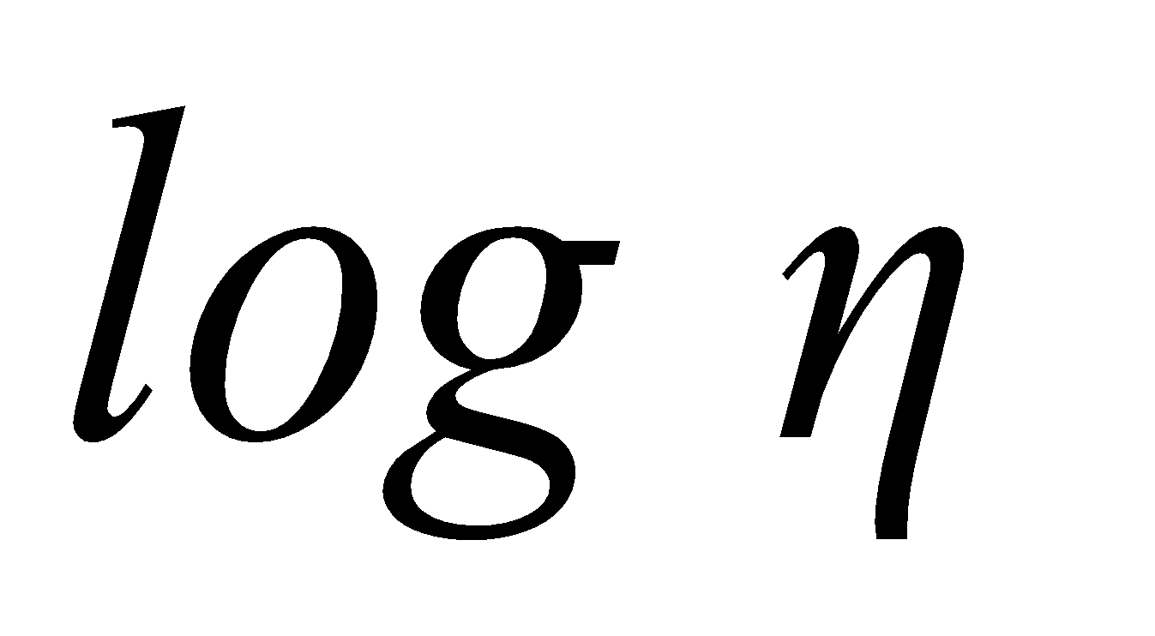
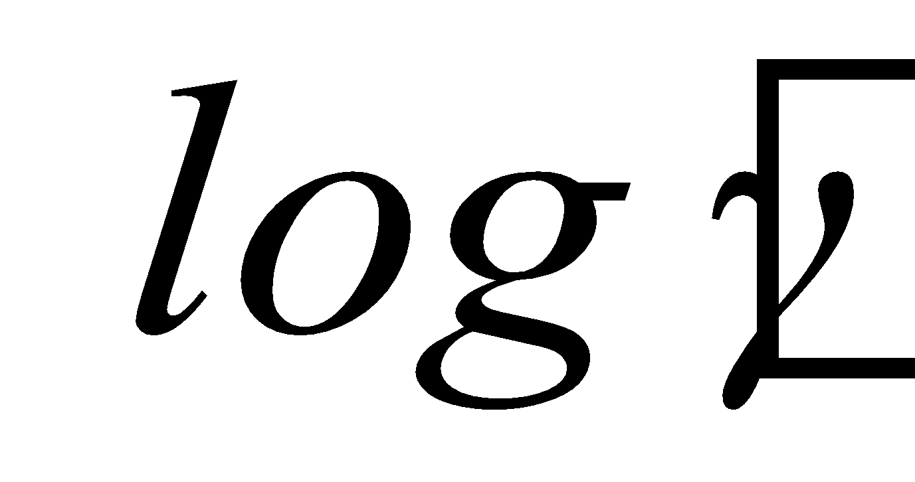
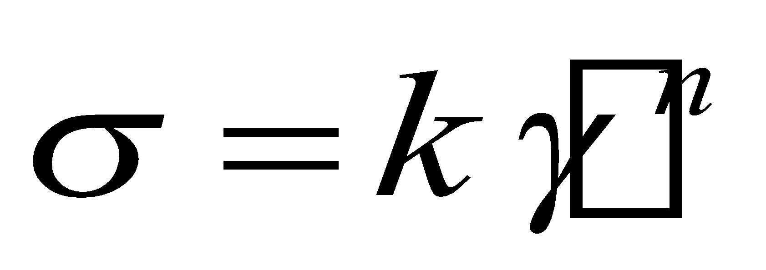
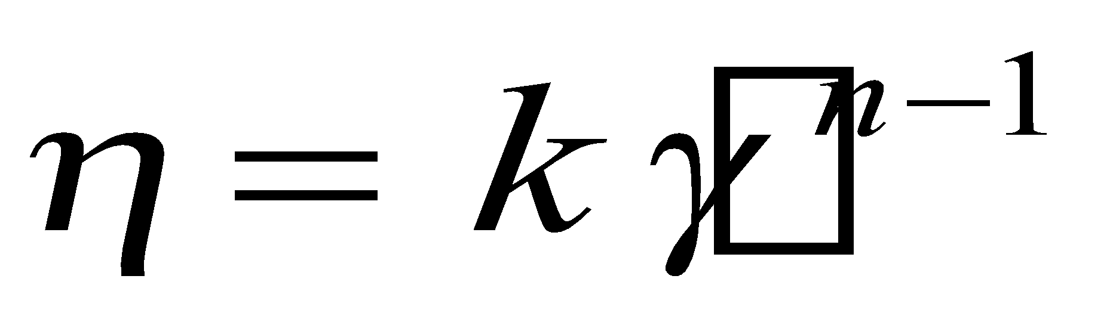
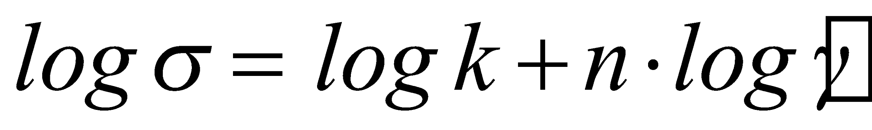
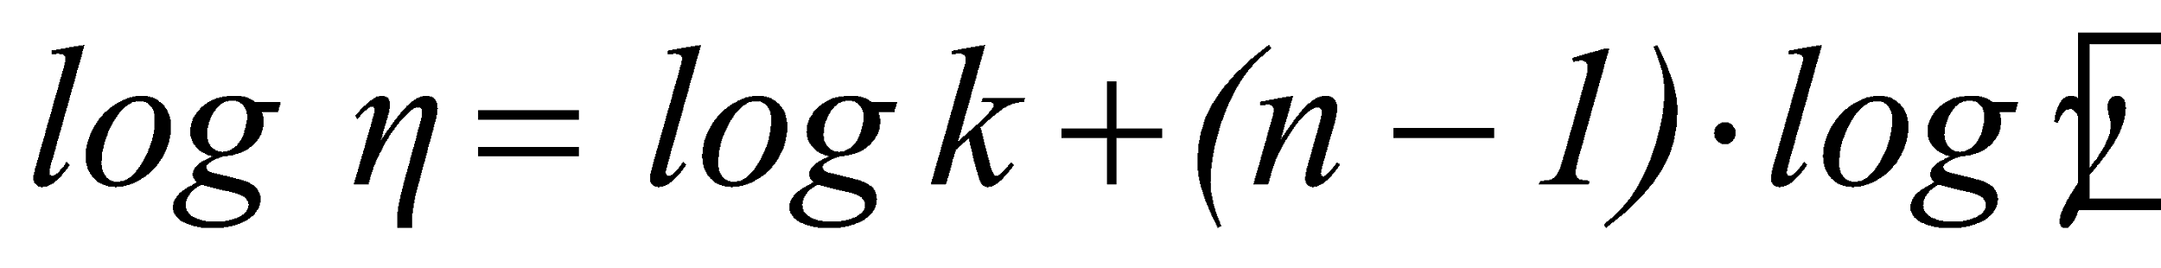


Pseudoplastic Liquids (n < 1)
Slope = n-1
Gums/Hydrocolloids
Emulsions
Tomato Sauce
Salad Dressing
Cream
Concentrated Protein Solutions
Dilatant Liquids (n > 1)
Slope = n
Starch Suspensions
Sand + Water

Slide 18


Starch Applications – Flow Curves
2.6% Tapioca Starch suspension heated
Slope=n
Slope=n-1

Slide 19




What are “plastic” liquids ?
Tomato Paste
Ketchup
Toothpaste
How do they behave? We need to squeeze or
push them so that the material flow
We can define a “yield” stress and compare
it with the applied stress
The material will not flow, it behaves as a solid
The material flows, it behaves as a liquid

Slide 20

Plastic Fluid Materials
Plastic shear thinning
Plastic Newtonian
“Binghan fluid”
Shear Stress
Plastic shear thickenning
Shear Rate

Slide 21


Plastic Materials – Rheological Model
Plastic shear thinning
Plastic Newtonian
“Binghan fluid”
Shear Stress
Plastic shear thickenning
Shear Rate
n = 1 Binghan Fluid
n < 1 Herschel-Bulkley Fluid
n > 1 very rare among foods

Slide 22






Summary of Rheological Models
Herschel-Bulkley
Bingham Fluid
Shear Thinning
Newtonian
Shear Thickening

Slide 23

Yield Stress Determination
Yield Stress is defined as the minimum shear stress to initiate flow
Static
Yield Stress
Flow Curve
Shear Stress
Dynamic Yield Stress
Shear Rate

Slide 24






Yield Stress determined using a controlled stress viscometer
Sample
Instrument
indicates error
because plate
does not rotates
Stress is
controlled

Slide 25








Plastic Fluid Materials
How could we determine the
rheological properties
Log-log plot of the rearranged
above equation
has to be determined
as described previously
n
Non-linear fitting for example using excel

Slide 26

“Plastic” Materials

Slide 27


“Plastic” Materials

Slide 28


Slide 29

Other Models used to describe the
rheology of inelastic “plastic” fluids
Model Equation
Casson
Modified Casson
Ellis
Generalized
Herschel-Bulkley
Carreau

Slide 30
TIME-DEPENDENT RHEOLOGICAL MATERIALS
Inelastic Fluids
Time-dependent behavior is due to changes in the structure of the material itself
Different than viscoelastic materials which also
have time dependent properties but they are not
associated to structural changes in the material under the action of shear for example.
Times associated with time-dependent behavior
associated with structure changes (Thixotropy or
Rheopexy) are longer than times associated with
viscoelastic behavior

Slide 31
Time Dependent Fluids
Rheopectic
Shear Stress
or Viscosity
Time Independent
Thixotropic
Time

Slide 32


Rheological Characterization of Liquids
Time independent liquids
Time dependent liquids

Slide 33



Thixotropic Behavior
Rest
Period
0
Time
Complete Recovery
Partial Recovery
No Recovery
0
Time

Slide 34
TESTING THIXOTROPIC BEHAVIOR
Shear Rate
Time
Shear Stress
Time

Slide 35


How could we characterize thixotropic behavior?
Apparent Viscosity
Time

Slide 36






Thixotropic Behavior
Apparent Viscosity
Time
Parameter somewhat
related with the structure
of the material
Time

Slide 37
Rheological Classification of Non-Elastic Liquids
Time
Independent
Newtonian
Pseudoplastic (shear thinning)
Dilatant (shear thickening)
Liquids
Time
dependent
Thixotropic
Rheopectic

Slide 38




Fluid | K | n |  | Typical Examples
Newtonian |  | 1 | 0 | Water, fruit juice, milk, honey, vegetable oil
Shear Thinning | > 0 | 0 < n < 1 | 0 | Applesauce, fruit puree, juice concentrate
Shear Thickening | > 0 | n >1 | 0 | Some types of honey, 40% raw corn starch
Bingham plastic |  | 1 | > 0 | Toothpaste Ice cream
Herschel-Bulkley | > 0 | 0 < n <1 | > 0 | Minced fish paste, ketchup, tomato products

Slide 39



Real Shear Thinning Behavior
Low Shear Rates
Shear Stress
Intermediate
Shear Rates
Large Shear Rates
Shear Rate
Viscosity
Shear Rate

Slide 40
Interpretation of Real Shear Thinning Behavior
Low V
Low Shear Rates
shear is not enough to align the particles
Brownian motion will “randomize”
the orientation of the particles
Particles
Intermediate V
Fluid serum
Intermediate Shear Rates
shear is enough to align the particles
High Shear Rates
High V
Viscosity
Shear Rate

Slide 41






Effect of Temperature on the
viscosity of liquids
For Newtonian Fluids
Arrhenius-type of equation
or

Slide 42





Effect of Temperature on the Viscosity of Liquids
Non Newtonian (Power Law fluid)
At a constant shear rate
By assuming that the flow index n does no vary much with Temperature

Slide 43

Effect of Temperature on Rheology of Starch Dispersions

Slide 44



Effect of Shear Rate and Temperature
on Apparent Viscosity
Effect of Temperature and Concentration
on Apparent Viscosity
Constants K_{T,C} , B and c
are determined from data

Slide 45

Effect of Temperature and Shear in a Starch Dispersion

Slide 46
How could we measure Rheological Properties?
Empirical Methods
Good for quality control and quality assurance purpose
Good to evaluate functional properties of ingredients under similar conditions to those of the application
Examples, RVA(Rapid Visco Analyzer), Texture Analysis
Not good for design purposes, to infer structural and/or molecular behavior of the sample
In general equipment is relatively inexpensive
Fundamentals Methods
Also good for quality control and quality assurance
Provide fundamental measurements, properties can be used for design and infer molecular and structural properties of the sample
In general more expensive than empirical methods

Slide 47



Results of RVA

Slide 48





How could we measure rheological properties?
Capillary Rheometer
Shear Stress Profile
Pressure
Forces
Friction
Forces
r
R
Flow
L
Pressure Forces = Friction Forces
Velocity
Profile

Slide 49




Calculation of shear rate in a tube
r
R
For a Newtonian Fluid

Slide 50







Capillary Rheometer
Q
R
L
Newtonian Fluid
- Shear Stress at the wall
- Shear Rate at the wall
- Pressure Loss
Hagen Poiseuille Equation.

Slide 51








Capillary Rheometer
Power Law Fluid
- Shear Stress at the wall
- Shear Rate at the wall
- Pressure Loss

Slide 52




Rotational Viscometry
Sample
Sample
Cone and Plate
Concentric Cylinders
Sample
h
Parallel Plates

Slide 53


CONCENTRIC CYLINDERS
Derivation of Basic Equations
FLOW IS LAMINAR
END EFFECTS ARE NEGLIGIBLE
FLUID IS INCOMPRESSIBLE
PROPERTIES ARE NOT FUNCTION OF TIME
TEMPERATURE IS CONSTANT
THERE IS NO SLIP AT THE WALLS
RADIAL AND AXIAL VELOCITY COMPONENTS ARE ZERO
R_{C}
R_{b}
Cup
h
Bob
Sample

Slide 54




CONCENTRIC CYLINDERS
Working Principle
Either the cup or the bob rotates
(or oscillates) at know rotational
speed (rpm or rad/s) and the
torque to maintain the speed is
measured
R_{C}
R_{b}
Cup
h
Bob
Measured Variables
Sample

Slide 55




Calculation of the Shear Stress at the Bob ( )
R_{C}
R_{b}
h
R_{b}
Shear Force

Slide 56





Calculation of the Shear Rate at the Bob ( )
Angular Velocity
Linear Velocity
r
Streamlines
(lines with the same
velocity)
it does not count
for the shear

Slide 57



Calculation of Shear Stress and Shear Rate
Shear Stress
Shear Rate
Newtonian
Rheology
Non-Newtonian

Slide 58




Calculation of the Shear Rate at the Bob ( )
1. Newtonian Fluid
R_{c}
R_{b}

Slide 59





Cone and Plate Geometry
Sample

Slide 60




Parallel Plates Geometry
Sample
h
Parallel Plates

